Slide 1
3주차 과제

Slide 2
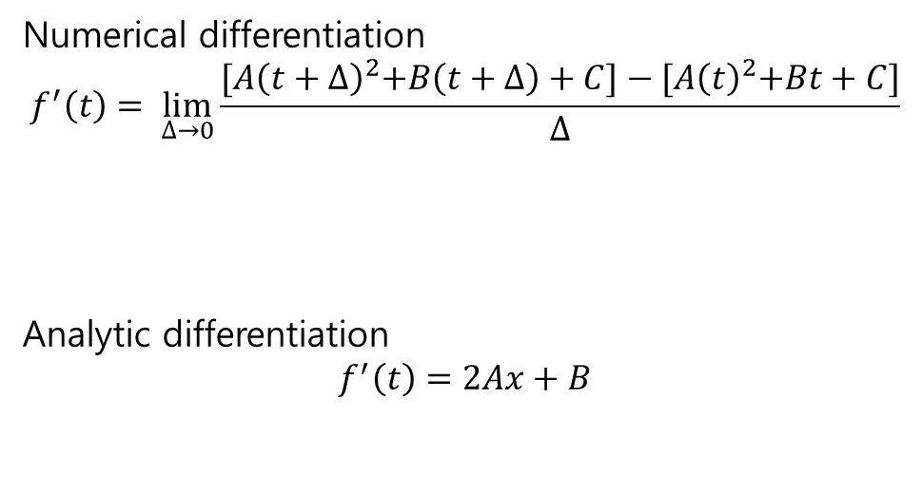

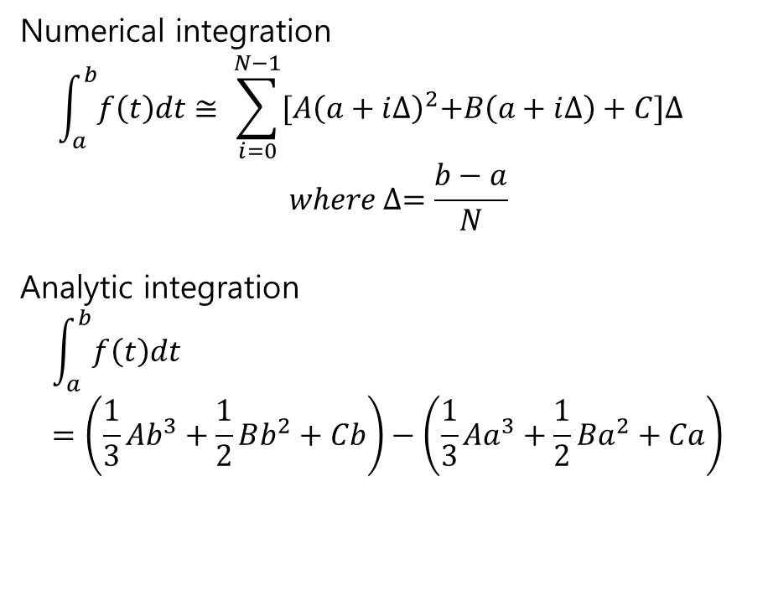
계획 및 설계
Polynomial Function
$$y=Ax^{2}+Bx+C$$
Numerical differentiation
$$f^{′}\left(t\right)= \lim_{∆→0}{\frac{{[A\left(t+∆\right)}^{2}+B\left(t+∆\right)+C]−{[A\left(t\right)}^{2}+Bt+C]}{∆}}$$
Analytic differentiation
$$f^{′}\left(t\right)=2Ax+B$$
Numerical integration
$$\int_{a}^{b}{f\left(t\right)dt}≅ \sum_{i=0}^{N−1}{{[A\left(a+i∆\right)}^{2}+B\left(a+i∆\right)+C]∆}$$
$$where ∆=\frac{b−a}{N}$$
Analytic integration
$$\int_{a}^{b}{f\left(t\right)dt}=\left(\frac{1}{3}Ab^{3}+\frac{1}{2}Bb^{2}+Cb\right)−\left(\frac{1}{3}Aa^{3}+\frac{1}{2}Ba^{2}+Ca\right)$$

Slide 3
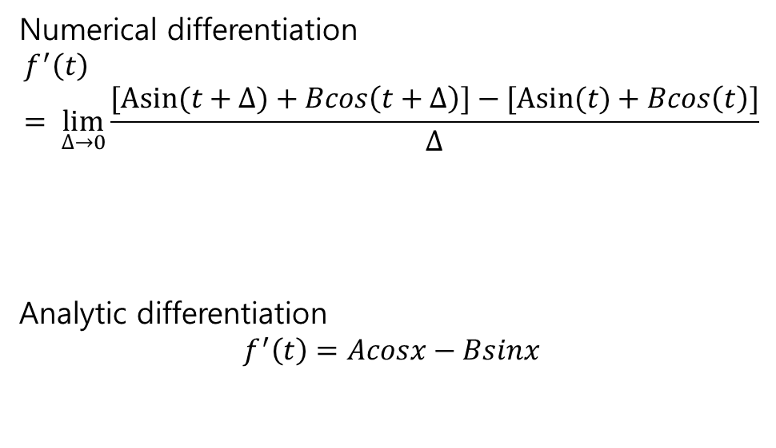
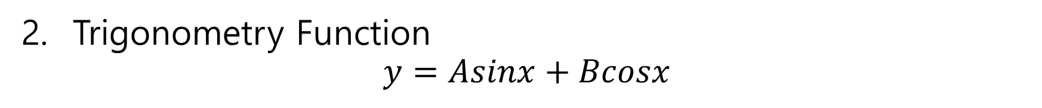
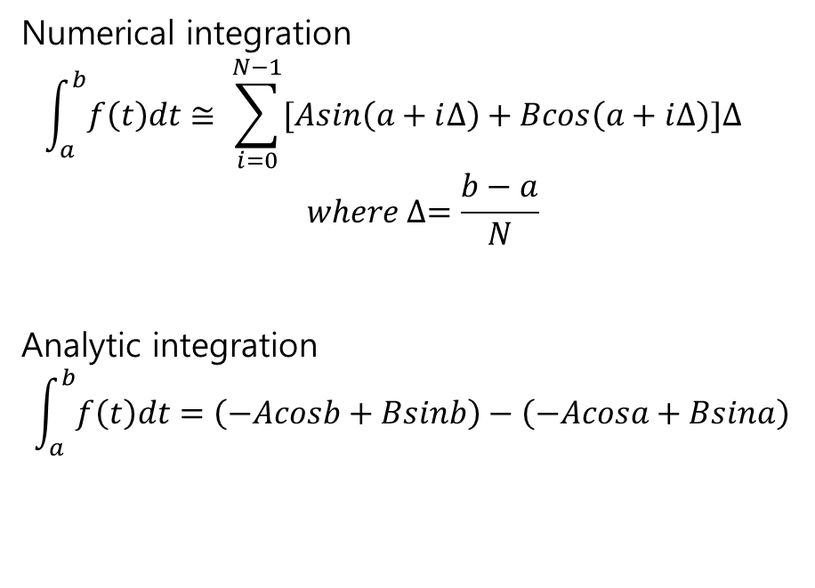
계획 및 설계
2. Trigonometry Function
$$y=Asinx+Bcosx$$
Numerical differentiation
$$f^{′}\left(t\right)= \lim_{∆→0}{\frac{[Asin⁡(t+∆)+Bcos\left(t+∆\right)]−[Asin⁡(t)+Bcos\left(t\right)]}{∆}}$$
Analytic differentiation
$$f^{′}\left(t\right)=Acosx−Bsinx$$
Numerical integration
$$\int_{a}^{b}{f\left(t\right)dt}≅ \sum_{i=0}^{N−1}{[Asin\left(a+i∆\right)+Bcos\left(a+i∆\right)]∆}$$
$$where ∆=\frac{b−a}{N}$$
Analytic integration
$$\int_{a}^{b}{f\left(t\right)dt}=\left(−Acosb+Bsinb\right)−\left(−Acosa+Bsina\right)$$

Slide 4


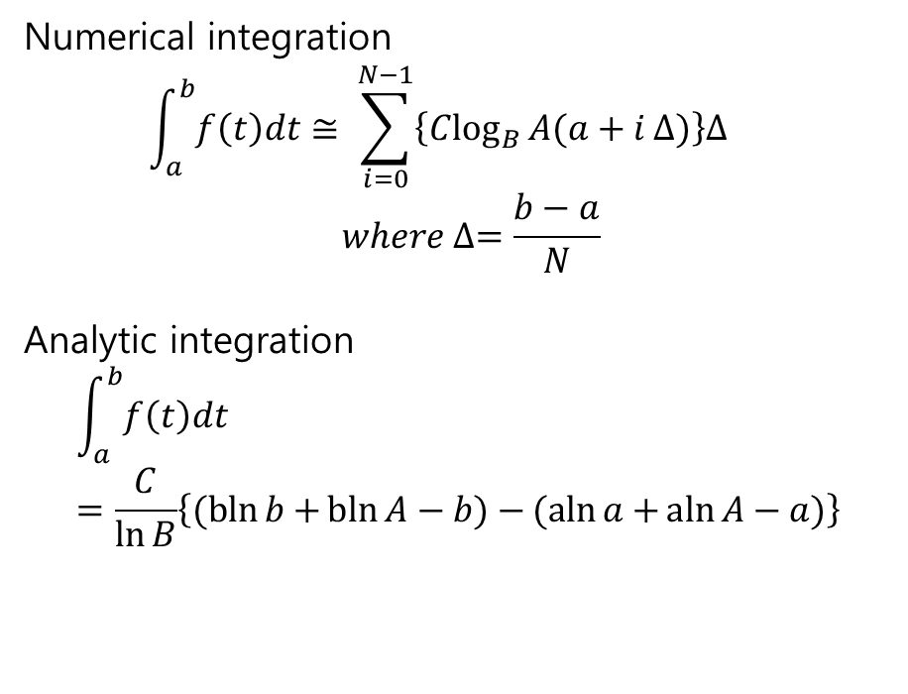
계획 및 설계
3. logarithmic function
$$y=C\log_{B}{Ax}$$
Numerical differentiation
$$f^{′}\left(t\right)= \lim_{∆→0}{\frac{C\log_{B}{A\left(t+dt\right)−C\log_{B}{At}}}{∆}}$$
Analytic differentiation
$$f^{′}\left(t\right)=\frac{C}{t\ln{B}}$$
Numerical integration
$$\int_{a}^{b}{f\left(t\right)dt}≅ \sum_{i=0}^{N−1}{\left\{C\log_{B}{A(a+i}∆)\right\}∆}$$
$$where ∆=\frac{b−a}{N}$$
Analytic integration
$$\int_{a}^{b}{f\left(t\right)dt}=\frac{C}{\ln{B}}\left\{(bln{b+}\operatorname{bln}{A−b)−}(aln{a+}\operatorname{aln}{A−a)}\right\}$$

Slide 5
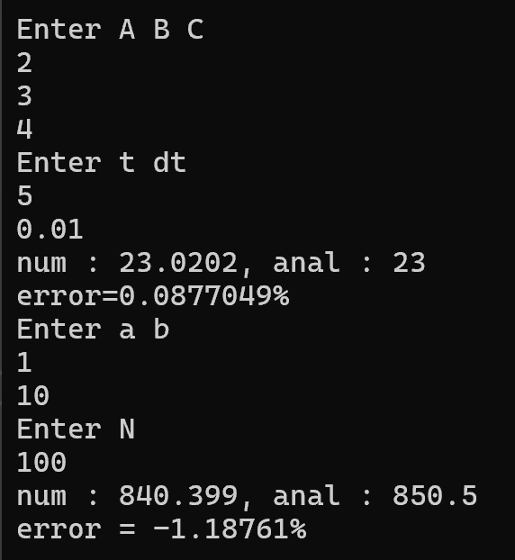
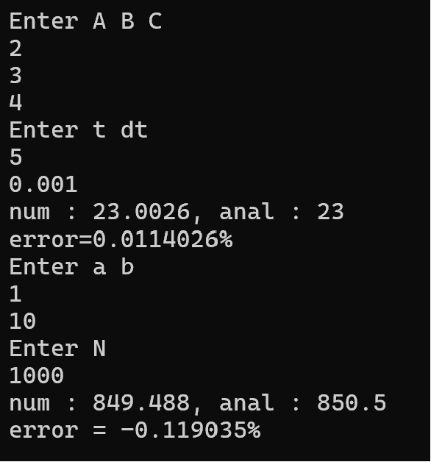
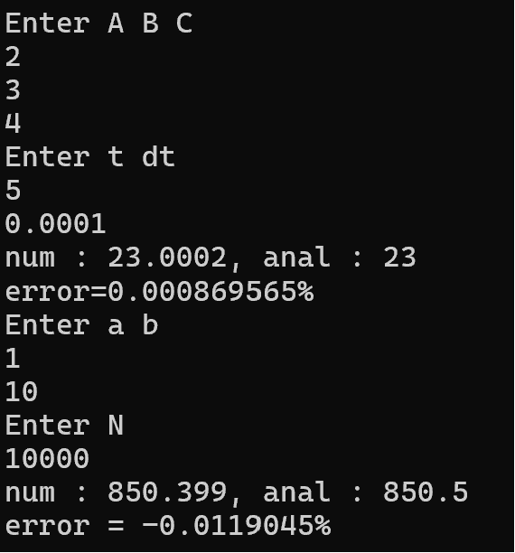
소스 및 결과
Polynomial Function
https://github.com/UserKhu/Week-3-HW/blob/main/polynomial
dt=0.01, N=100
dt=0.001, N=1000
dt=0.0001, N=10000

Slide 6
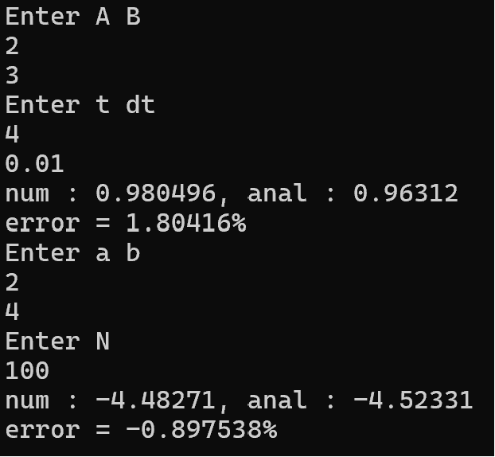
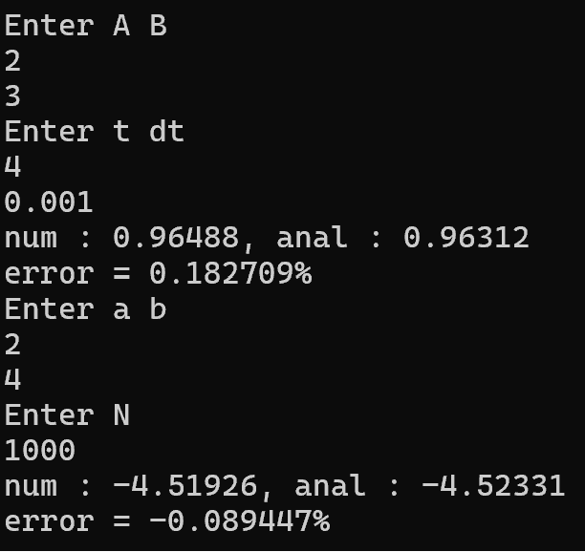
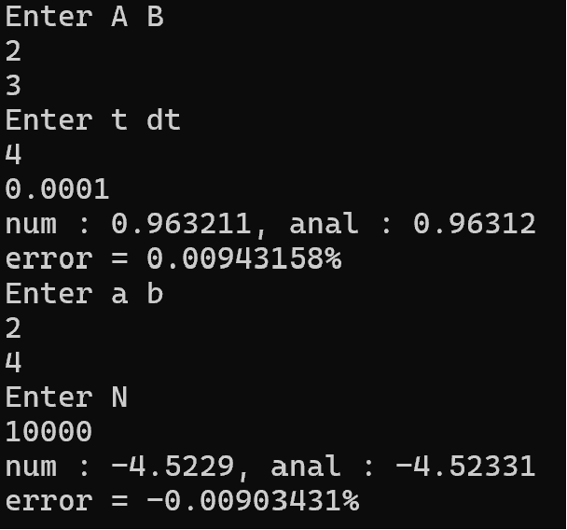
소스 및 결과
2. Trigonometry Function
https://github.com/UserKhu/Week-3-HW/blob/main/trigonometry
dt=0.01, N=100
dt=0.001, N=1000
dt=0.0001, N=10000

Slide 7
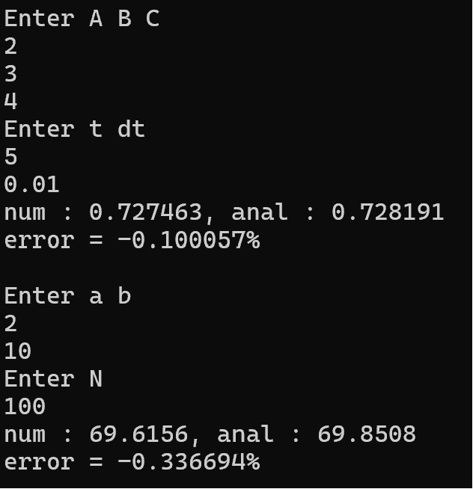
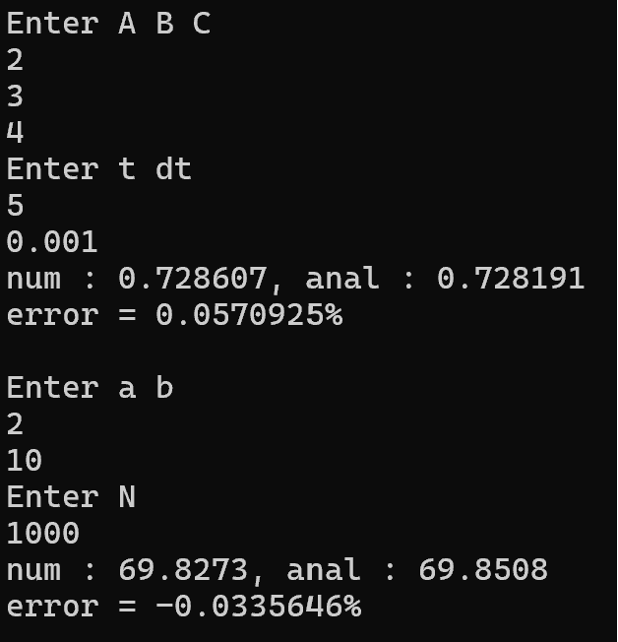
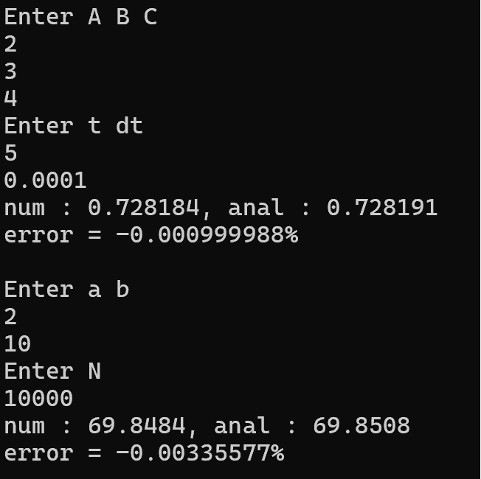
소스 및 결과
3. logarithmic function
https://github.com/UserKhu/Week-3-HW/blob/main/log
dt=0.01, N=100
dt=0.001, N=1000
dt=0.0001, N=10000

Slide 8
결론
dt 값이 감소, N의 값이 증가함에 따라 두 가지의 방법 모두 오차율이 감소한다.

